Slide 1
Catch that fruit!
Honami Iida | Naoni Choi | Srishti Singh

Slide 2
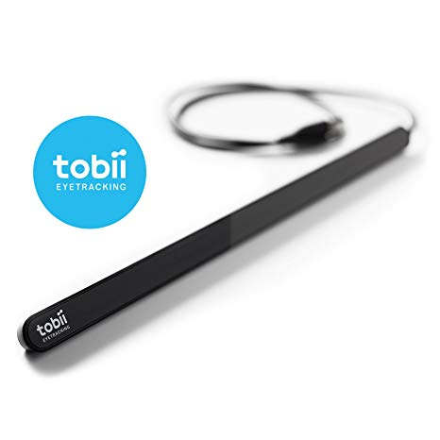
TECHNOLOGY
New and exciting
Many possibilities
Easy to use with the gaze aware component
Simple mechanic
It is sort of magical...
Everything is great except that it can be used only on windows

Slide 3
CONCEPT
UNSEEING THE SEEN
How can we deceive our eyes to see only what we want to?
The concept is tested using ripe and rotten fruits as a medium. The player needs to keep a balance of what he is seeing(consuming) in order to win.

Slide 4
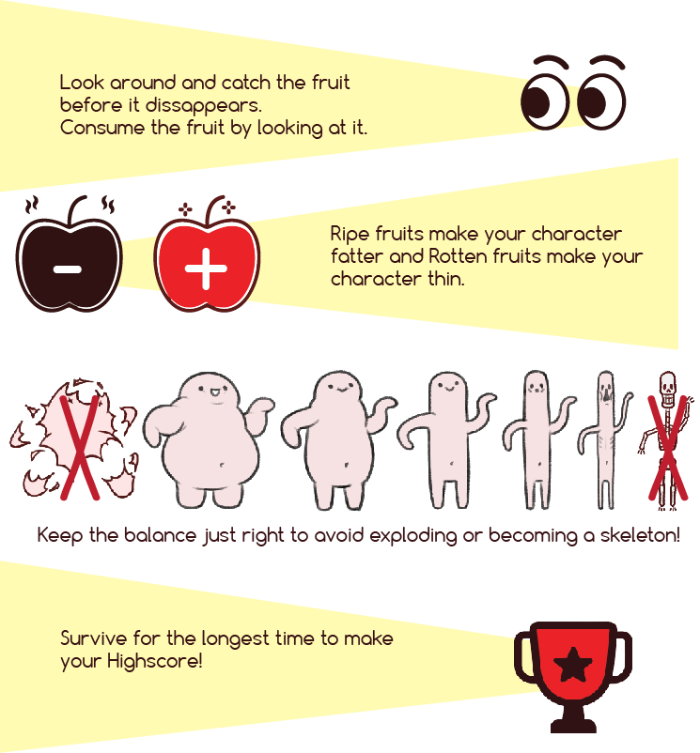
HOW TO PLAY
You are an Alien that loves fruits, you eat them by looking at them. Just be careful to consume the right fruits.

Slide 5
Things we would like to add
Multiplayer
Assigning different colours to different players
Distractions and bonus
Bonus fruits for extra time, exploding fruits for sudden end
Combos and quests
Searching for specific fruits to get combos or complete quests
Hidden worlds
Entering special areas that are being guarded
Animation and Interaction
Improve interaction with animation and sound effects. Give an idea of the sight on screen.

Slide 6
Where it started
Imagine playing whack a mole by looking like you are mind controlling it

Slide 7
How it changed
Let's make it an awesome multiplayer game where you get positive points for our colour mole and negative for the other players colour mole(while they get a bonus)
Let’s first make it single player and time based
Let’s make Tobii work, then we can think of adding things
Yaaayy! Its working...Let’s collect fruits with positive and negative effects, it can be implemented faster

Slide 8
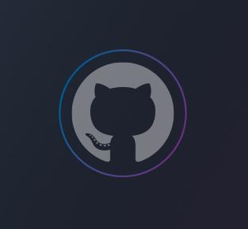
HONAMI IIDA
development
NAONI CHOI
artwork
SRISHTI SINGH
design
https://github.com/Honami0612/Tobii

